Slide 1
Interesting Facts About Space
Makarovskiy Denis, 2026

Slide 2
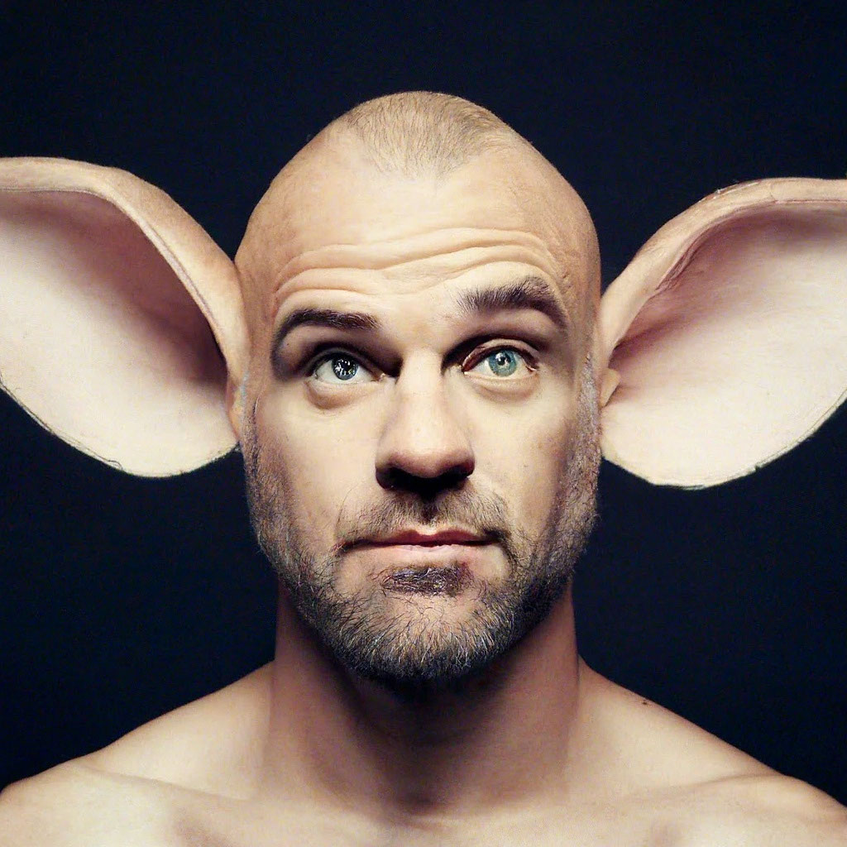
Space is completely silent
There is no air in space, so sound cannot travel. Astronauts cannot hear each other without radios.

Slide 3
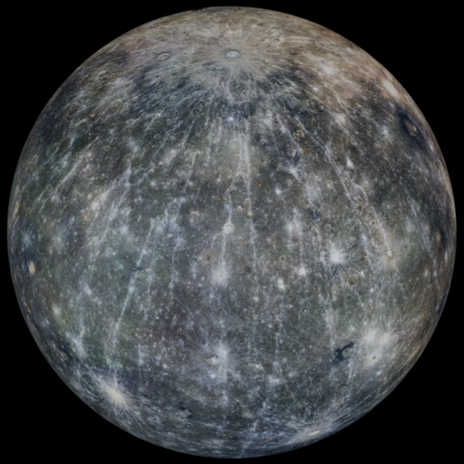
The hottest planet is not the closest to the Sun
Even though Mercury is closest to the Sun, Venus is the hottest planet because its thick atmosphere traps heat.

Slide 4
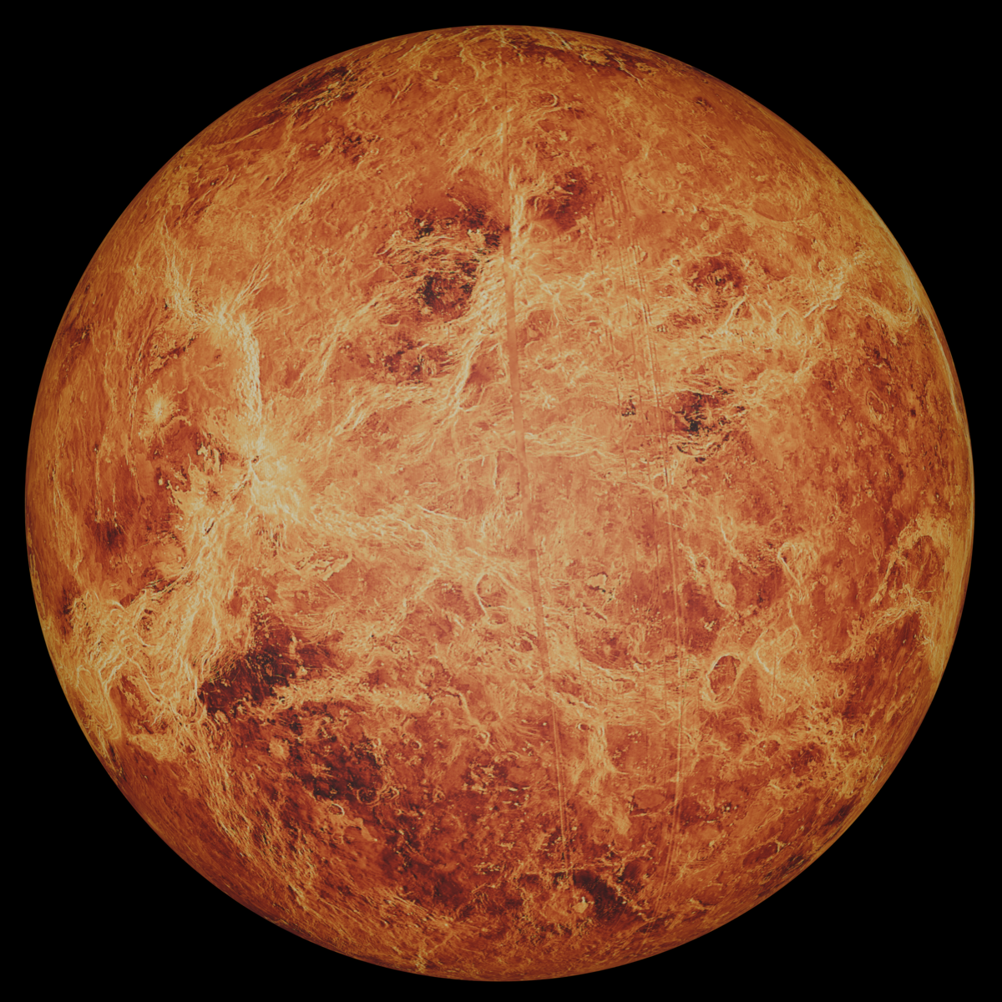
A day on Venus is longer than a year
On Venus, one full rotation takes longer than it takes to orbit the Sun!

Slide 5
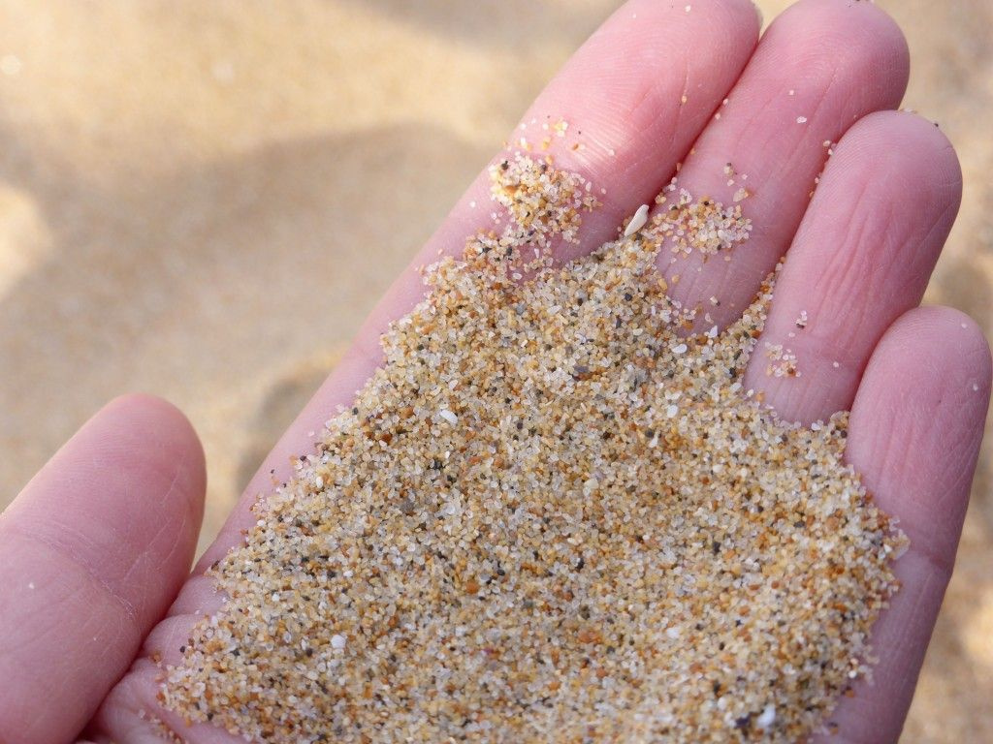
There are more stars than grains of sand
Scientists believe there are more stars in the universe than grains of sand on all the beaches on Earth.

Slide 6
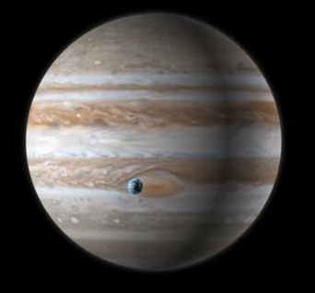
The Largest Planet in Our Solar System
Jupiter is so big that more than 1,300 Earths could fit inside it.

Slide 7
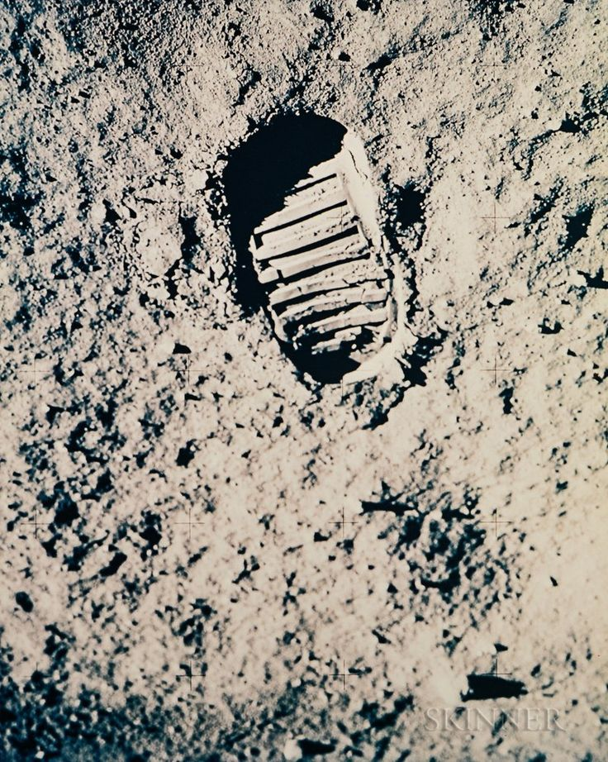
Footprints on the Moon
Because there is no wind on the Moon, astronaut footprints can stay there for millions of years.

Slide 8
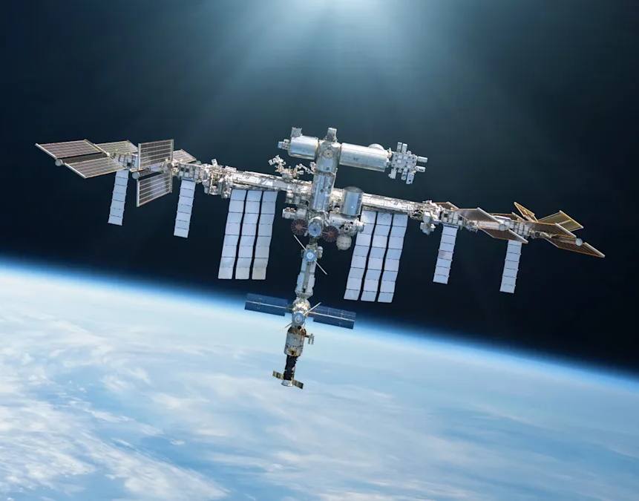
The International Space Station
The International Space Station travels around Earth at about 28,000 km per hour and circles our planet about 16 times a day!

Slide 9
Thanks for listening!

